Slide 1
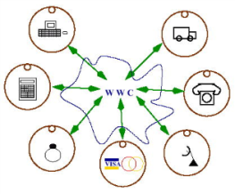

Wind-Aware Trajectory Planning for Fixed-Wing Aircraft in Loss of Thrust Emergencies
SASWATA PAUL
FREDERICK HOLE
ALEXANDRA ZYTEK
CARLOS A. VARELA
WORLDWIDE Computing Laboratory
DEPARTMENT OF COMPUTER SCIENCE
Rensselaer Polytechnic Institute
The 37th DASC, London – September, 2018

Slide 2
Background-Dynamic Data-Driven Avionics Systems
To facilitate development of smarter (flight) data streaming systems, we investigate:
  Programming technology to facilitate modeling spatio-temporal data streaming applications
    PILOTS (ProgrammIng Language for spatiO-Temporal data Streaming applications)
  Error detection using error signatures and
  error correction based on data redundancy
  Machine learning techniques to infer
  relationships from data
    Offline supervised training
    Online prediction and learning

Slide 3
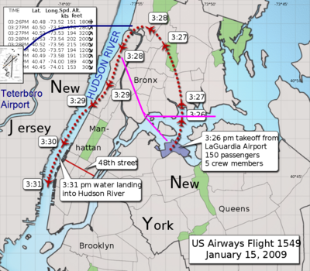
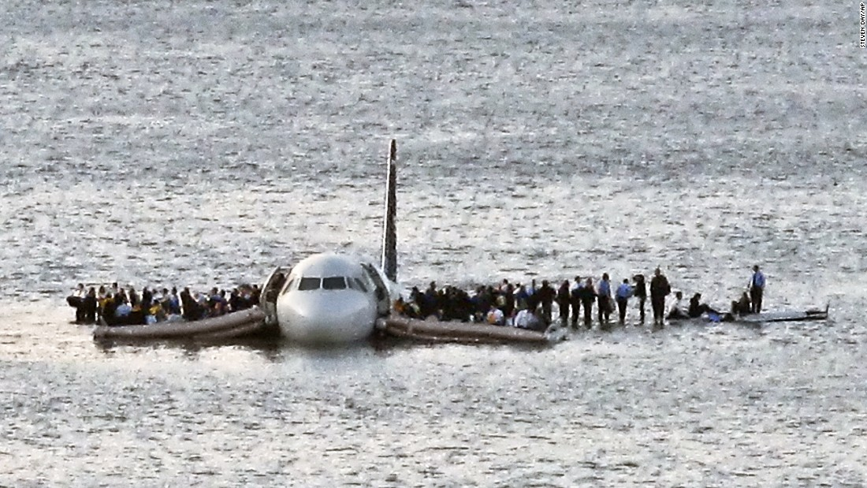
US Airways Flight 1549
Need for real-time decision support: US Airways flight 1549
  Caused by birds strike damaging both engines
  The pilots successfully ditched in the Hudson river
Image courtesy: cnn.com
Image courtesy: wikipedia.com

Slide 4
Dynamic Data Driven Avionics
Our Goal: To create a dynamic data driven trajectory generation system to assist pilots in such situations by taking into consideration dynamic aspects such as partial power, wind, etc.
Our model uses geometric criteria for generating trajectories using different bank angles and corresponding radii of turn and glide ratios for different drag configurations.
Our aircraft model is parameterized on a Baseline Glide Ratio for clean aircraft configuration assuming best gliding airspeed in straight flight.
We dynamically infer the baseline glide ratio to update our model in order to accurately reflect the current performance of the aircraft.

Slide 5
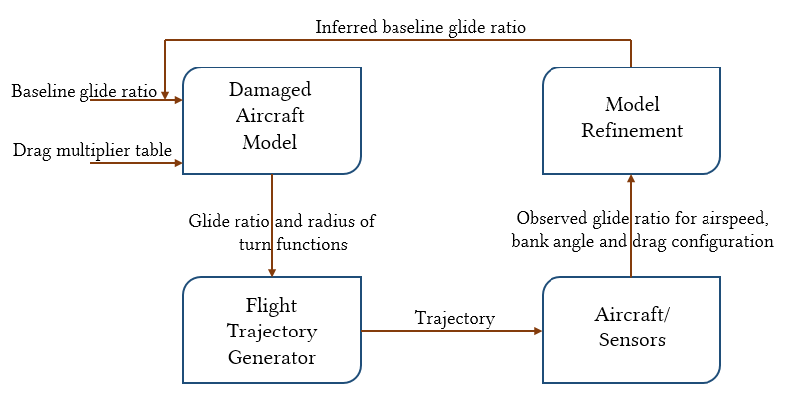
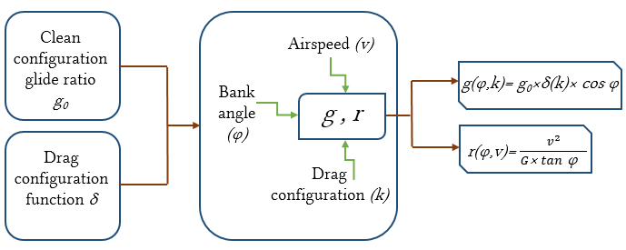
Dynamic Data Driven Model
Fig: Dynamic Data Driven Flight Trajectory
Generation
Fig: Damaged Aircraft Model

Slide 6
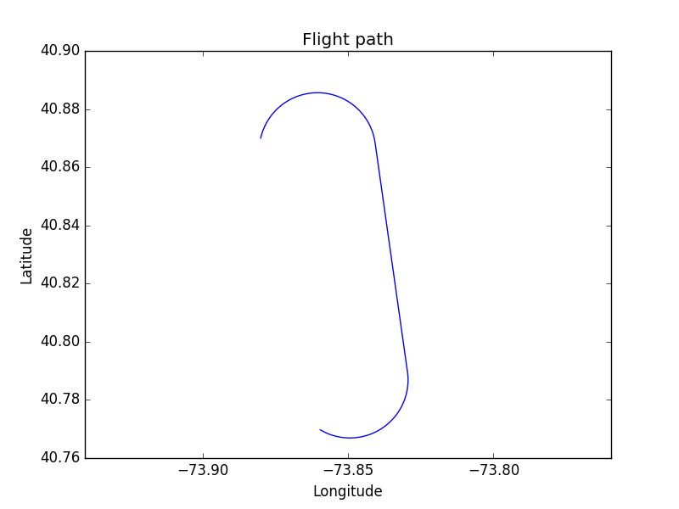
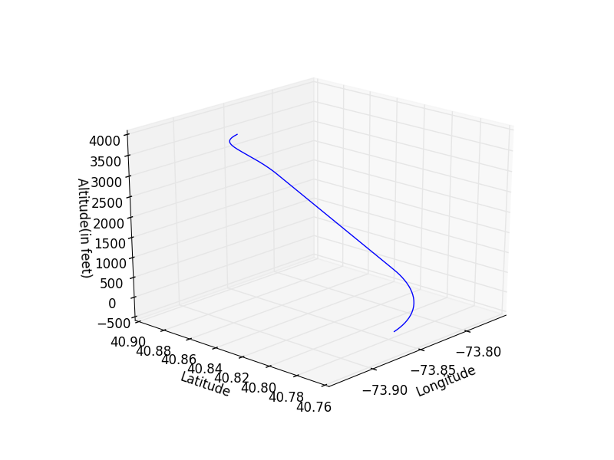
Low-altitude trajectories
For a given runway and a given bank angle, we have two scenarios:
  Low Altitude scenario:
  In this case, the trajectory consists of a simple Dubins Airplane Path that brings the aircraft to the runway.

Slide 7
High-altitude trajectories
  High Altitude scenario:
  When a simple Dubins Airplane Path brings the aircraft too high above the runway.
  We find an intermediate point to lose excess altitude by extending the final approach along the runway heading.
  In this case, the trajectory consists of:
    A simple Dubins Airplane Path to bring the aircraft over the runway
    An integral [0,1,2….] number of spiral turns to lose excess altitude
    An Extended Runway of length X ∈ [0, 2πR g/g₀ ) if integral number of turns cannot bring the aircraft down to the runway at proper altitude.
    A landing configuration glide ratio and airspeed is assumed for the extended runway segment.

Slide 8
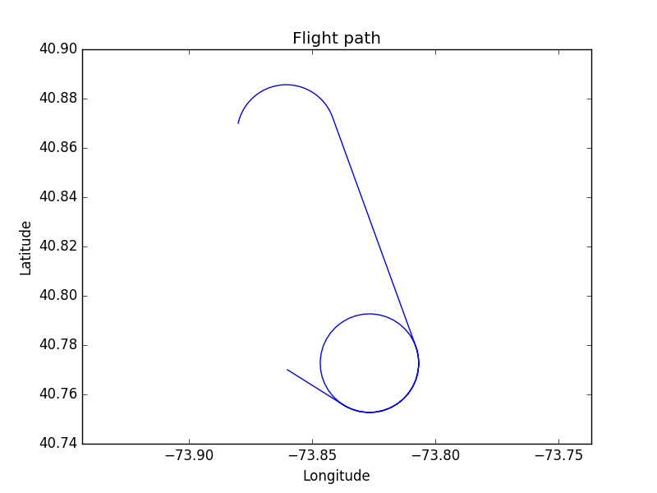
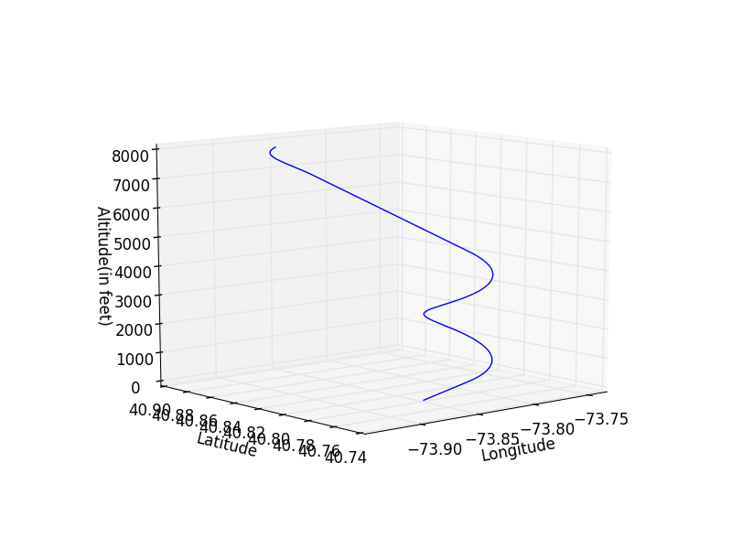
High-altitude trajectories
High Altitude Scenario where number of spirals > 0

Slide 9
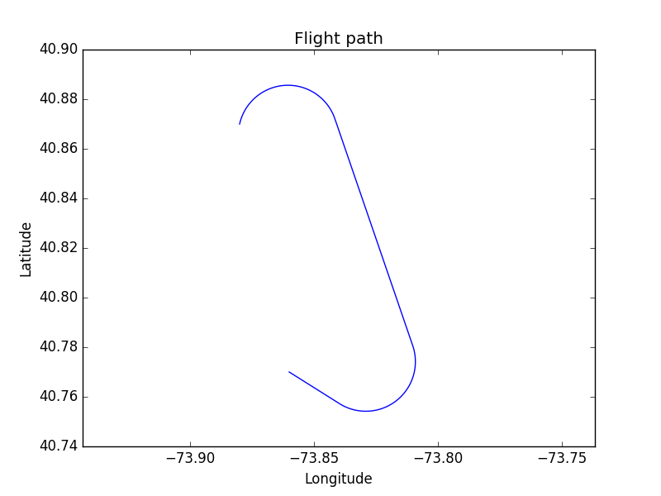
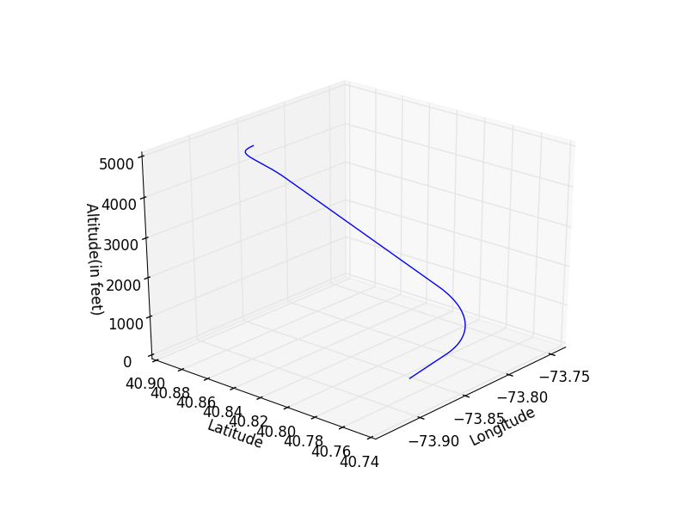
High-altitude trajectories
High Altitude Scenario where number of spirals = 0

Slide 10
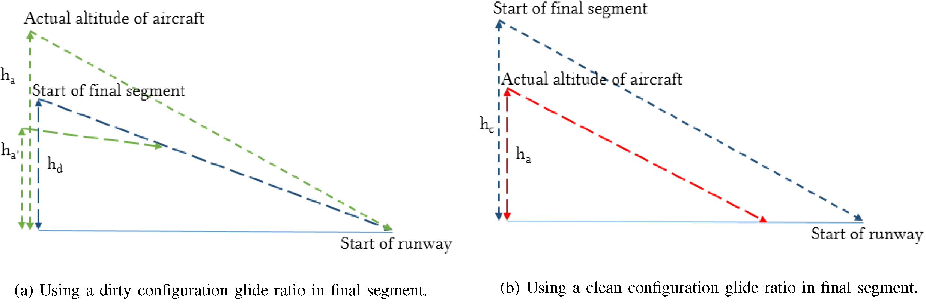
Extended Runway Segment
We use a dirty (landing) configuration glide ratio in the extended runway segment to make sure that the starting point of this segment is at an altitude from which the aircraft can make it safely to the runway.

Slide 11
Trajectory Safety Metrics
We introduce safety metrics to evaluate trajectories.
Evaluation of trajectories makes it possible for a pilot to make a better informed choice in a shorter time.
The Metrics are:
  Average altitude
  Average distance from runway
  Average bank angle over height
    measures the occurrence of steep turns near the ground
  Total time
  Extended final runway segment distance
  Number of turns

Slide 12
Trajectory Safety Metrics
Each metric is normalized relative to the minimum or maximum (whichever is desired) and then evaluated in our safety metric equation
We introduce an Utility Function computed by taking a weighted average of all the metrics
This Utility Function is then used to rank the trajectories generated according to their – higher value of utility function implies better trajectory and a better rank
The utility function can be easily modified to account for other factors like Wind

Slide 13
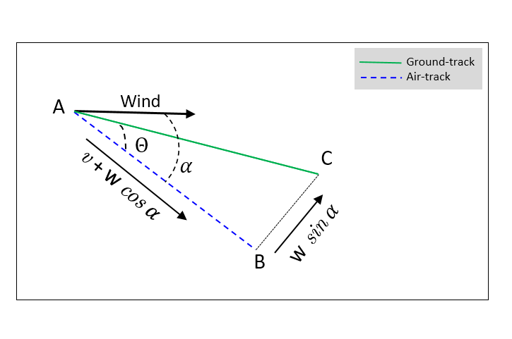
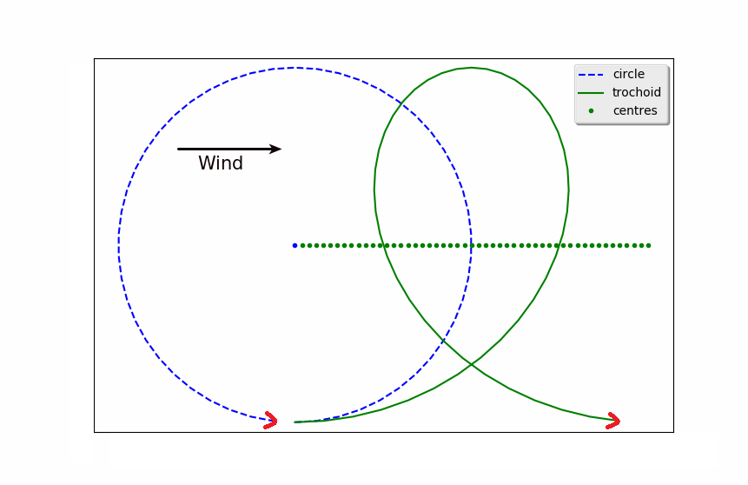
Effect of Wind on Trajectories
Wind has a profound impact on the shape of flown trajectories with respect to the ground.
Effect of wind on straight flight Effect of wind on turns

Slide 14
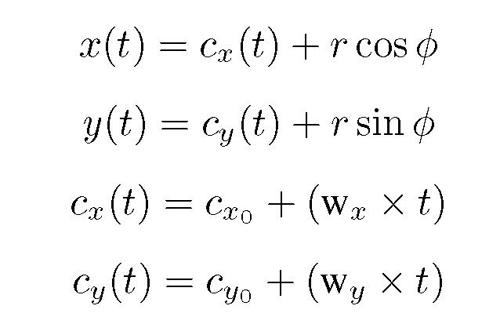
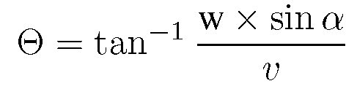
Effect of Wind on Trajectories
In the presence of wind, turns have ground-tracks that are trochoidal rather than circular.
Straight line flights create ground-tracks that are different (have a crab angle).

Slide 15
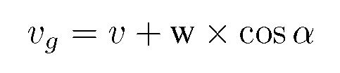
Effect of Wind on Trajectories
Therefore, in the presence of wind the ground-tracks may be significantly altered, taking an aircraft away from the intended runway.
Wind also affects ground-speed -- a tail-wind can increase ground-speed while a head-wind can decrease it; thereby affecting the effective gliding range of a gliding aircraft.
A trajectory generated without considering wind may become invalid in the presence of wind
Therefore, wind has to be considered in the generation phase itself

Slide 16
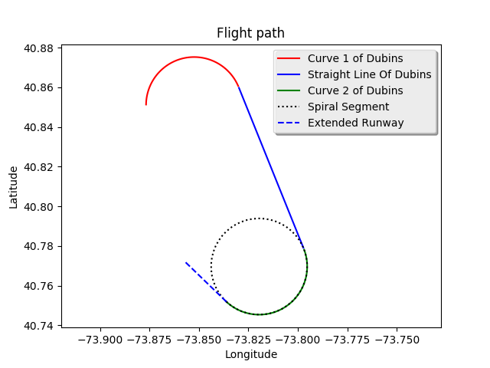
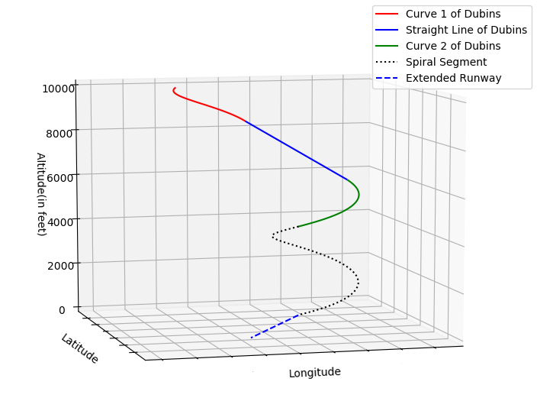
Effect of Wind on Trajectories
Parts of a typical trajectory
Our typical trajectory has 5 unique segments
Each segment is affected by wind in a different way

Slide 17
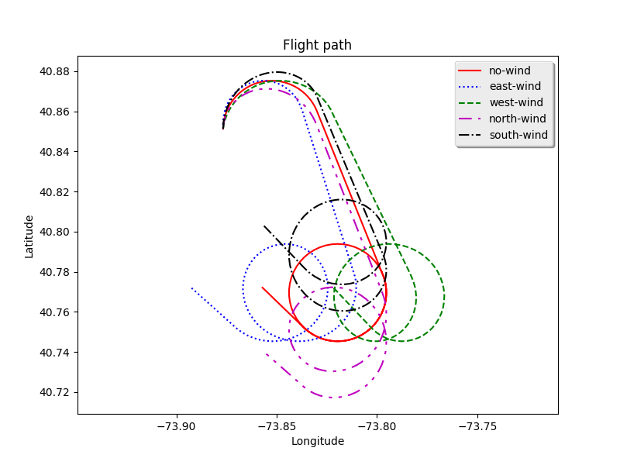
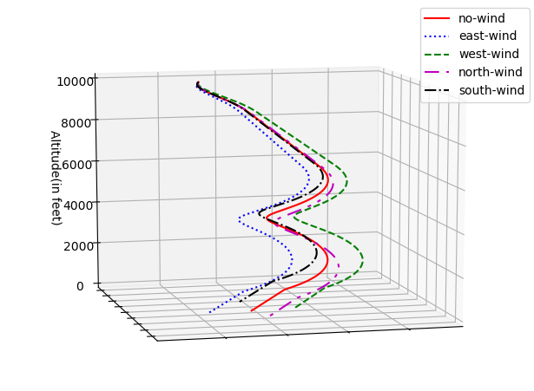
Effect of Wind on Trajectories
Effect of a 40 knot wind from different directions

Slide 18
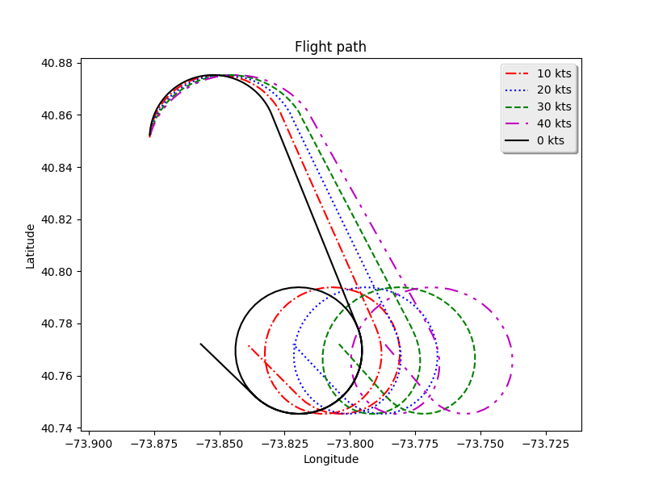
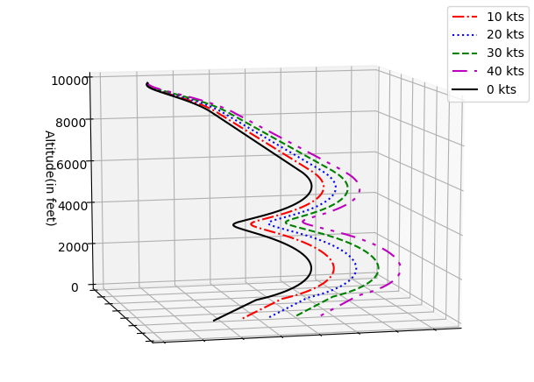
Effect of Wind on Trajectories
Effect of a West-wind of different magnitudes

Slide 19
Generating Wind-Aware Trajectories
We define the following:
An air trajectory is a trajectory flown with respect to the moving airmass
The corresponding ground trajectory is the 3D projection with respect to the ground frame of reference
A no-wind air trajectory is not corrected for wind and might take an aircraft away from the target runway
A wind-aware air trajectory is corrected for wind so that it can lead an aircraft to a runway in the presence of wind

Slide 20
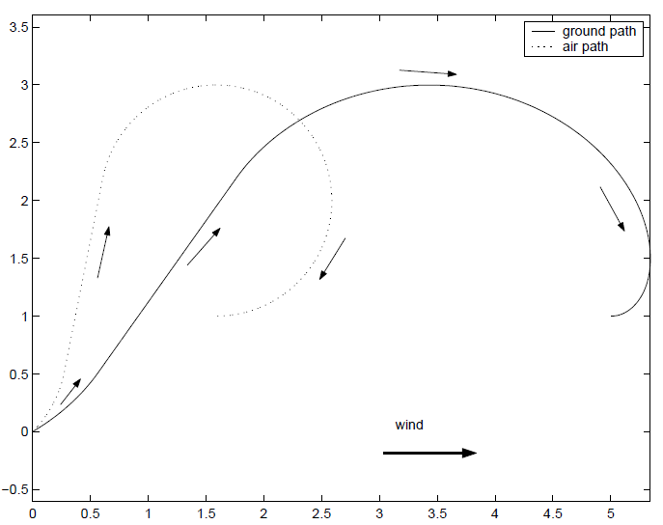
Generating Wind-Aware Trajectories
A wind-aware trajectory is a trajectory to a virtual runway, the ground trajectory of which can bring an aircraft to the position of the actual target runway, in the 3D space.
The virtual runway is a point lying in the upwind direction from the target runway.

Slide 21
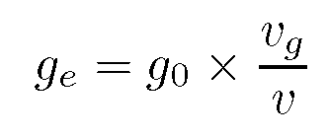
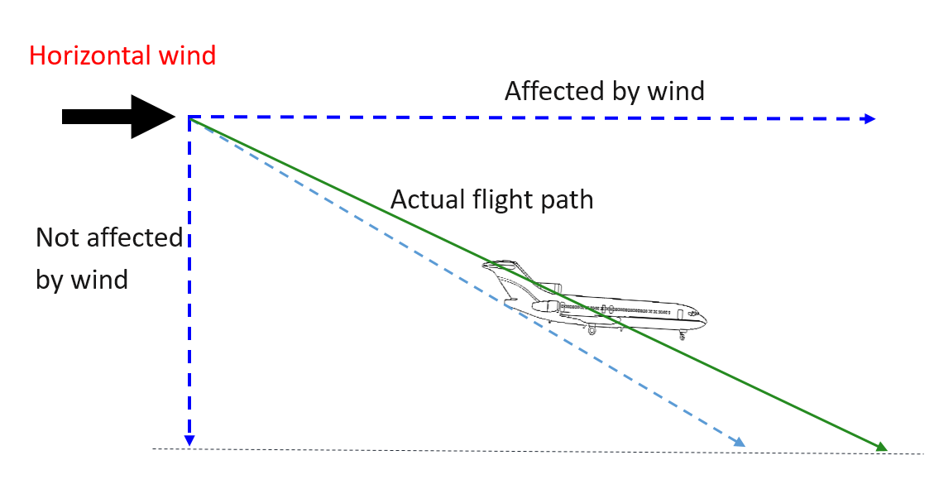
Generating Wind-Aware Trajectories
In the presence of horizontal wind, the effective baseline glide ratio (g_{e}) with respect to the ground is different from the aerodynamic baseline glide ratio (g₀).
However, the rate of descent remains unaffected by horizontal wind as it has no vertical component.

Slide 22
Generating Wind-Aware Trajectories
Two conditions need to be met by a valid wind-aware trajectory:
The trajectory must be able to bring the aircraft down to the altitude of the runway.
The end of the trajectory must meet the coordinates of the runway in the two-dimensional space.

Slide 23
Generating Wind-Aware Trajectories
Therefore, in order to compute valid trajectories, we make the following assumptions:
The aircraft always flies with the best gliding airspeed v.
For each segment in an air trajectory, time t is required to fly that segment with respect to the airmass.
The aircraft follows each segment of the air trajectory for time t.

Slide 24
Generating Wind-Aware Trajectories
Assumptions 1, 2 and 3 imply that a ground trajectory will lose exactly the same amount of altitude as the corresponding air trajectory since time in air is equal – ensuring Condition I.
The problem is thus reduced to finding a virtual runway such that Condition II holds true.

Slide 25
Generating Wind-Aware Trajectories
We propose an analytical solution for calculating the virtual runway for trajectories where the Dubins path segment is of the form Right-Straight-Right or Left-Straight-Left.
We also propose a heuristic iterative solution for cases that are not covered by our analytical formula.
We were able to generate wind-aware trajectories in under 50 milliseconds on an Intel Core i7-7500U CPU - 2.70GHz.

Slide 26
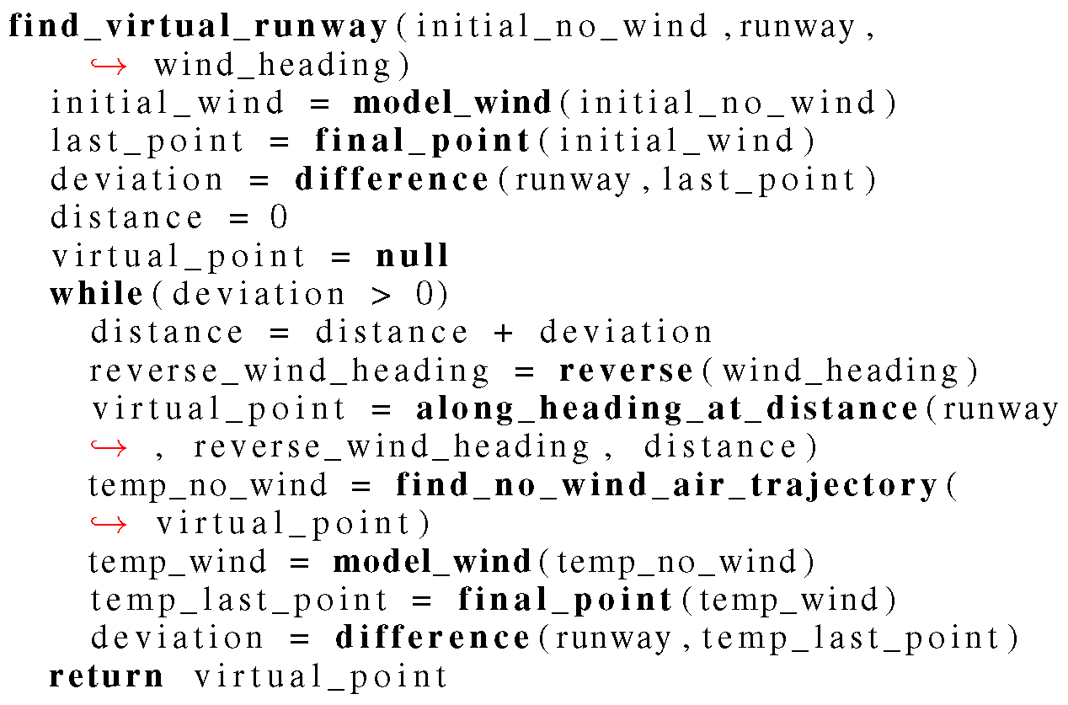
Generating Wind-Aware Trajectories
Heuristic iterative algorithm.

Slide 27
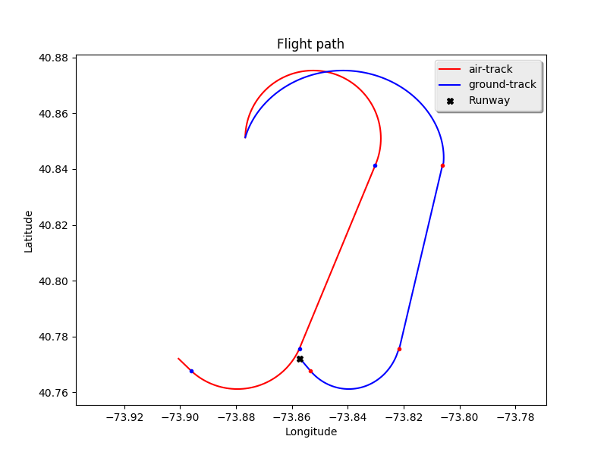
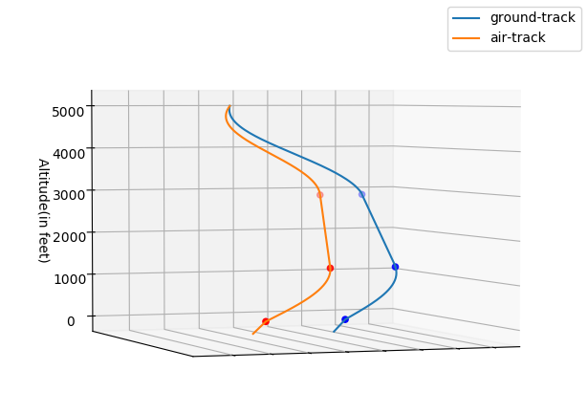
Generating Wind-Aware Trajectories
Wind-aware trajectory from 5000 feet in 40 knots West-wind
Wind-aware trajectory from 5000 feet in 40 knots West-wind

Slide 28
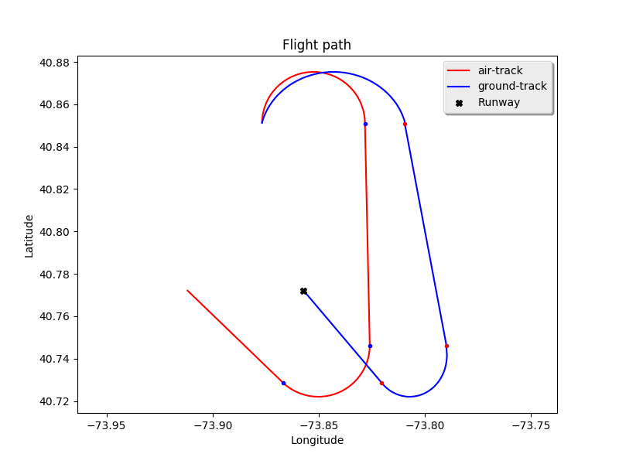
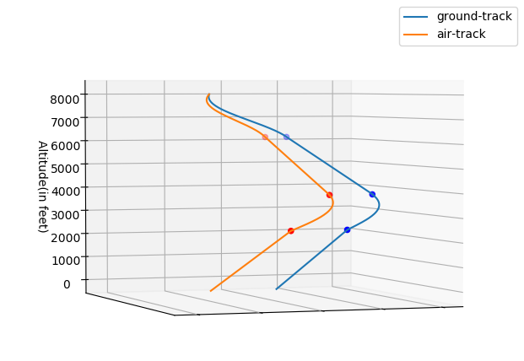
Generating Wind-Aware Trajectories
Wind-aware trajectory from 8000 feet in 40 knots West-wind

Slide 29
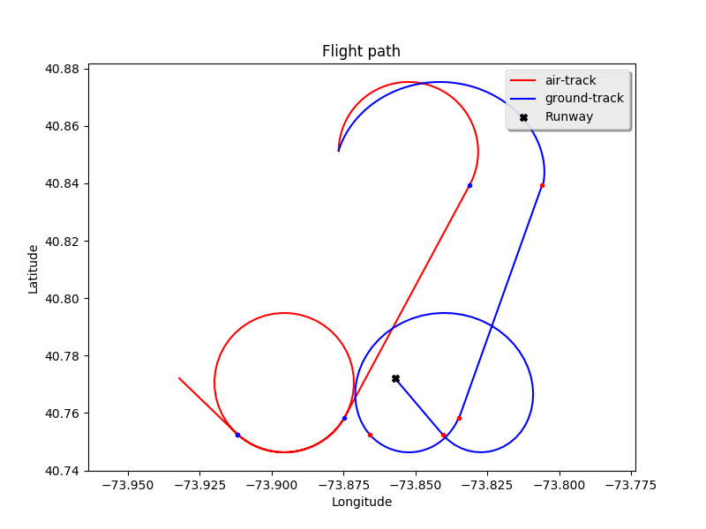
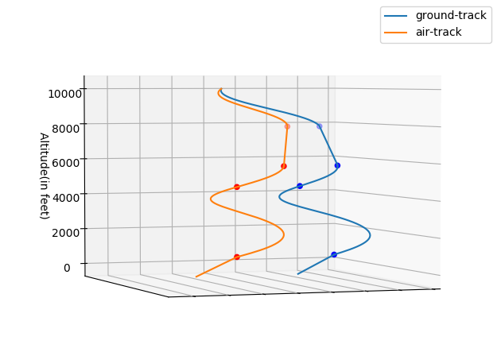
Generating Wind-Aware Trajectories
Wind-aware trajectory from 10000 feet in 40 knots West-wind

Slide 30
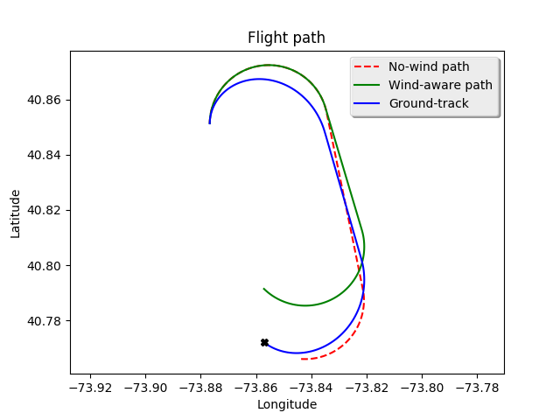
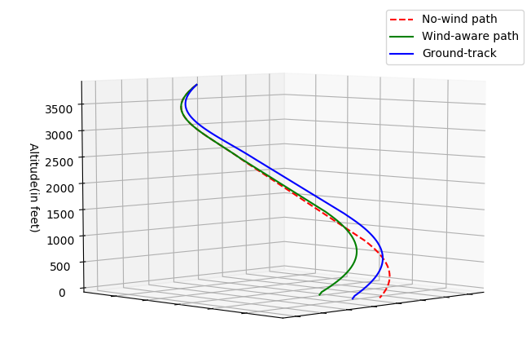
Generating Wind-Aware Trajectories
We successfully generated a wind-aware trajectory to LGA31 from an altitude of 3850 feet, assisted by a 30 knots North-wind, even though a no-wind trajectory in the same configuration was not possible.

Slide 31
Discussion
With a proper wind model, it is possible to design prediction based dynamic data-driven systems that can generate wind-aware 3D trajectories in the event of a loss-of-thrust scenario.
Trajectories generated are of the highest fidelity since they take into consideration the capabilities of the damaged aircraft and the prevailing wind conditions during an actual emergency.
It allows us to compute wind-assisted trajectories when no-wind trajectories are not possible.
Considering wind in the trajectory generation phase itself may present new wind-assisted options or reject options rendered infeasible by wind.

Slide 32

Questions?
Download open-source PILOTS at:
http://wcl.cs.rpi.edu/pilots
Partial support from:
Air Force Office of Scientific Research
DDDAS Program
Dr. Frederica Darema
(AFOSR Grant No. FA9550-11-1-0332, FA9550-15-1-0214),
National Science Foundation
EAGER/Dynamic Data Program
(NSF Grant No. ECCS 1462342),
Consider textbook:
MIT Press, June 2013

Slide 33
Extra Slides

Slide 34
Calculation of Baseline Glide Ratio
Calculation of baseline glide ratio in the MODEL REFINEMENT component:
Horizontal distance covered in previous 4 seconds
v_{t,} v_{t-1,} v_{t-2,} v_{t-3,}
Observed Baseline Glide ratio at time instant t
Aircraft sensors
Altitude loss in previous 4 seconds
z_{t,} z_{t-1,} z_{t-2,} z_{t-3,}

Slide 35

Calculation of Baseline Glide Ratio
Calculation of baseline glide ratio in the MODEL REFINEMENT component:
𝝎
Is standard deviation in 𝝎
< 𝝈_{T} ?
Return baseline glide ratio at time t
t_{i-1}
To detect window of continuous descent
Taken mean over window 𝝎
To check for stable change in glide ratio in window

Slide 36
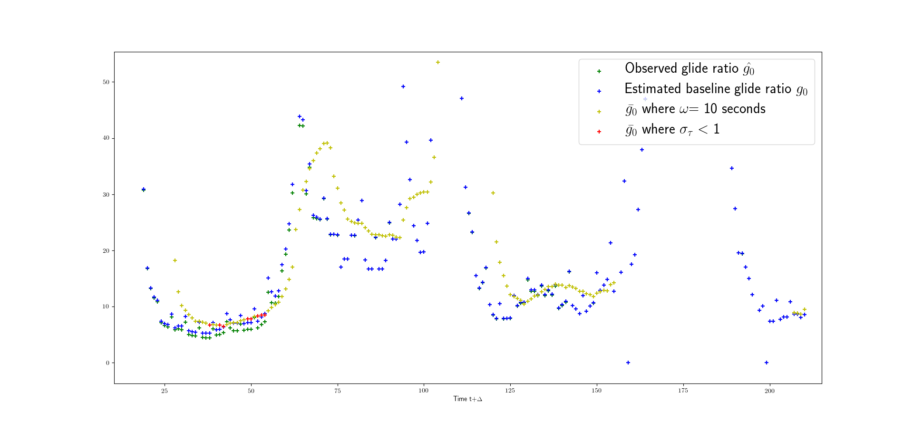
Calculation of Baseline Glide Ratio
With 𝝎=10 and 𝝈T=1: NOT ENOUGH VALUES
US Airways 1549 data

Slide 37
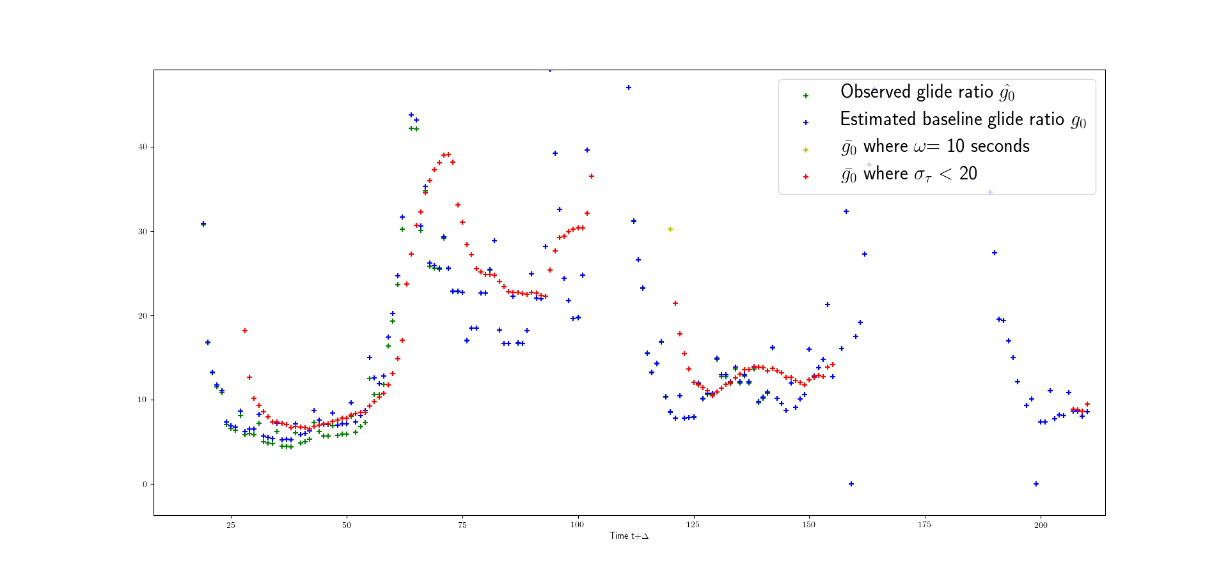
Calculation of Baseline Glide Ratio
With 𝝎=10 and 𝝈T=20: NOISY
US Airways 1549 data

Slide 38
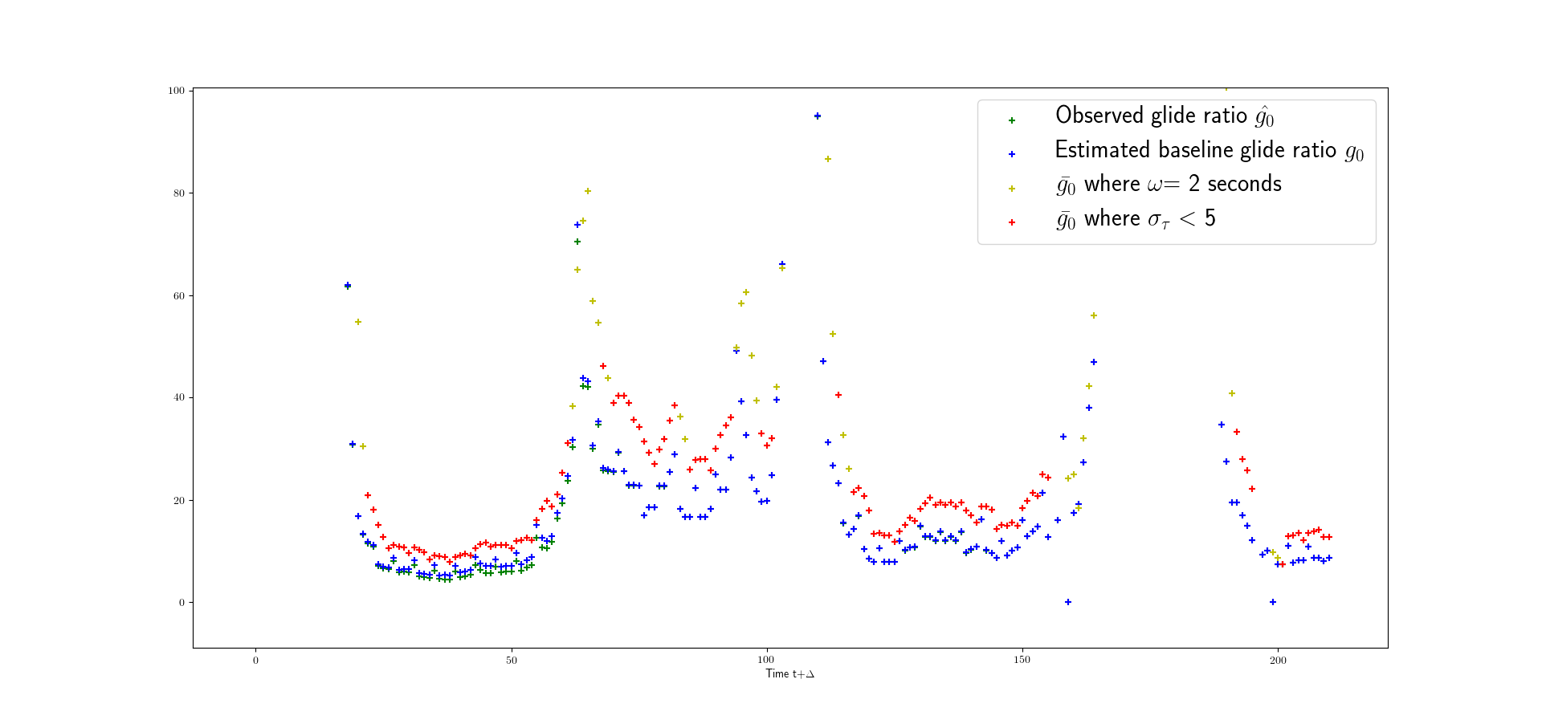
Calculation of Baseline Glide Ratio
With 𝝎=2 and 𝝈T=5: NOISY
US Airways 1549 data

Slide 39
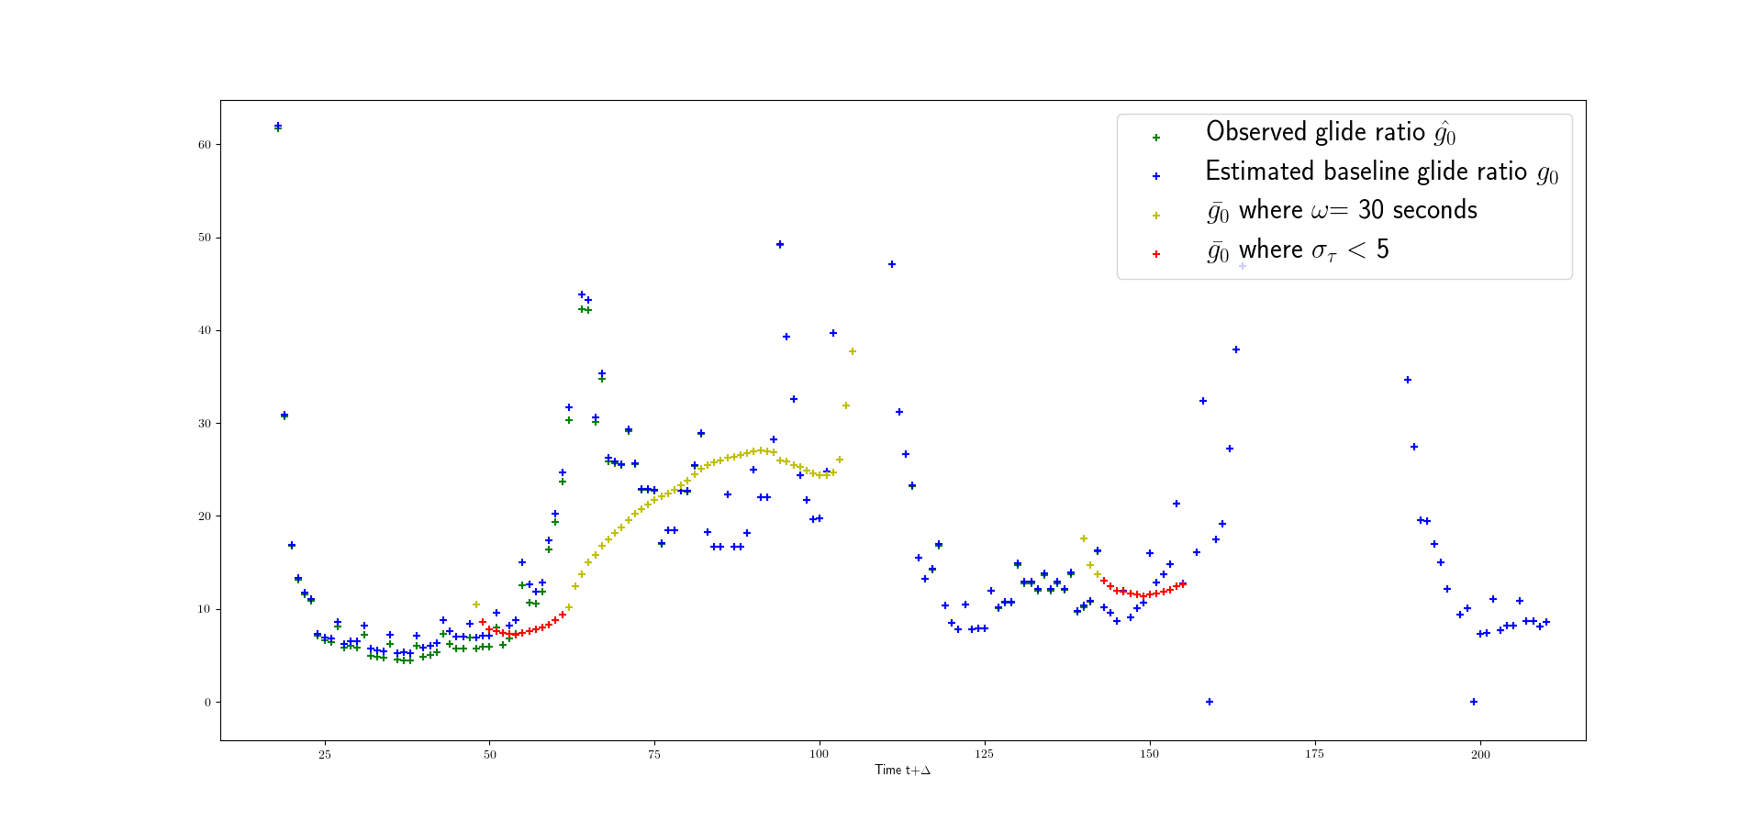
Calculation of Baseline Glide Ratio
With 𝝎=30 and 𝝈T=5: NOT ENOUGH VALUES
US Airways 1549 data

Slide 40
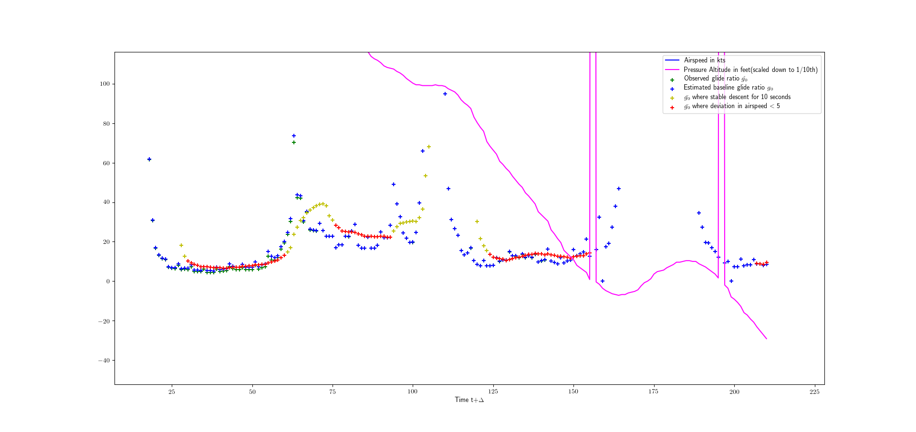
Calculation of Baseline Glide Ratio
With 𝝎=10 and 𝝈T=5: GOOD
US Airways 1549 data

Slide 41
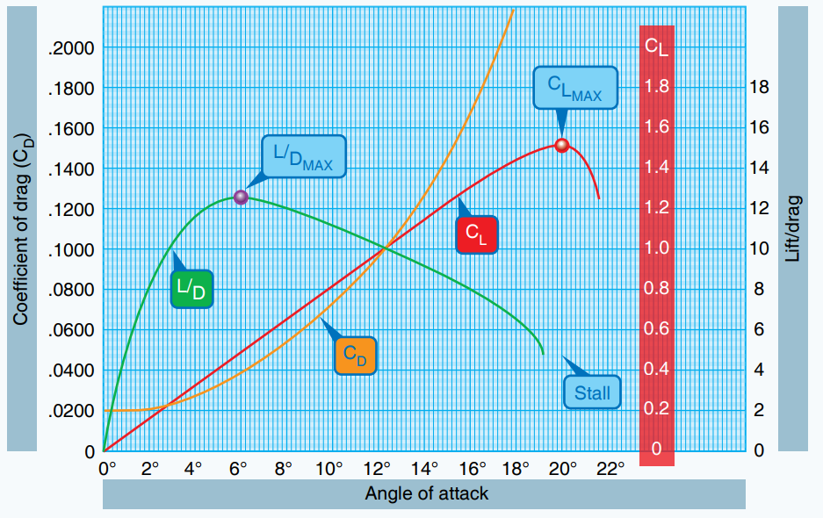
Best gliding angle of attack (airspeed)
In order to maximize the gliding distance of the aircraft, the L/D ratio must be maximized by flying at the optimal speed.
Image courtesy: faa.gov

Slide 42
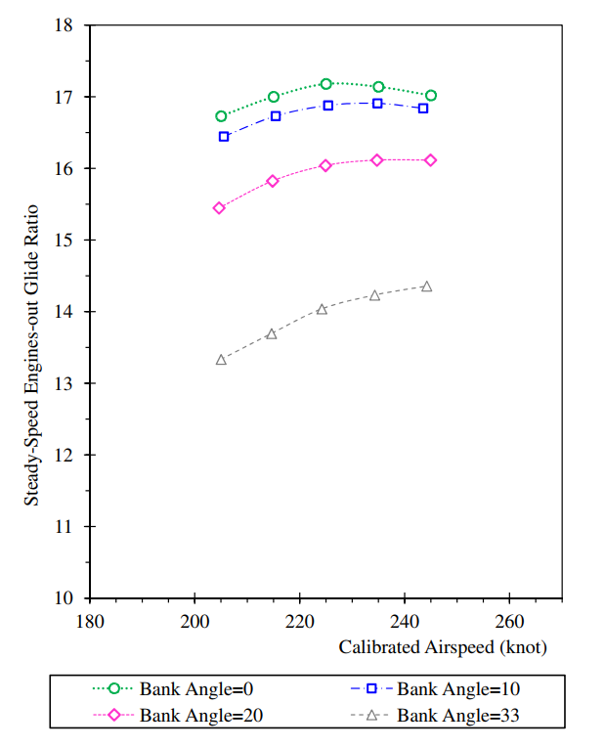
Effect of bank angle on glide ratio
Fig: Steady-speed engines-out glide ratio vs. airspeed observed in the A320-200
(Avrenli and Dempsey, 2015)

Slide 43
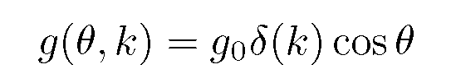
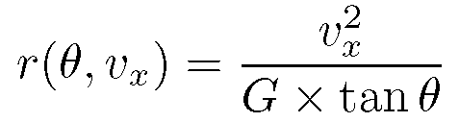
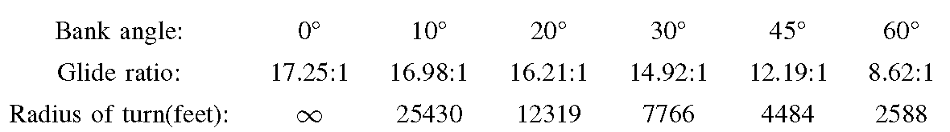
Loss of thrust aircraft model
Bank angle has a significant impact on the radius of turn and glide ratio, hence we use different bank angles to generate possible trajectories.
Glide ratios and radii of turn for different bank angles for an Airbus A320 at 225 kts

Slide 44
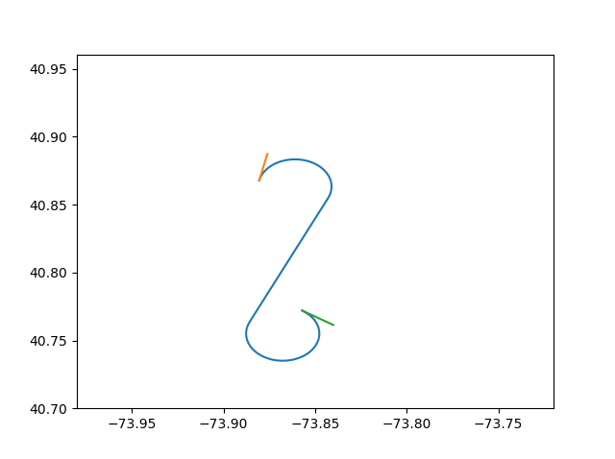
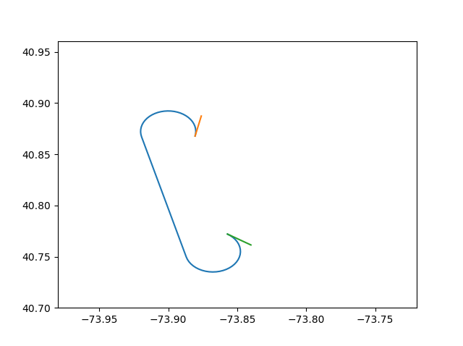
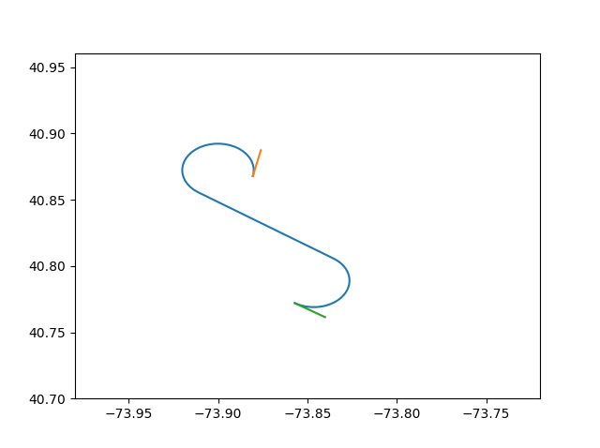
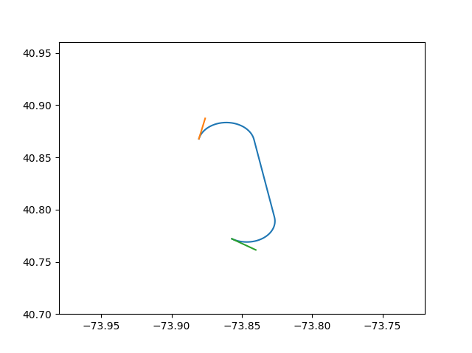
2D Dubins Paths
2D Dubins Path:
  Four options with a straight line segment: LSR, RSR, LSL, RSL
  The shortest one is chosen
RSL
LSL
LSR
RSR

Slide 45
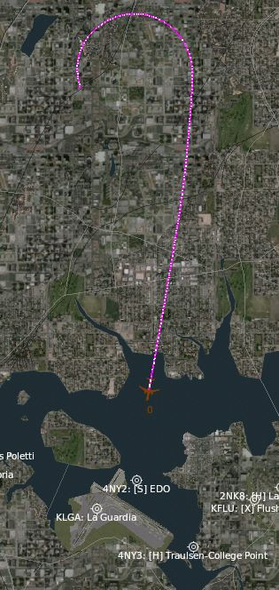

Improvements over Existing Work
Fig: (Atkins, 2009) trajectory vs simulator for t+12 sec to LGA 22

Slide 46


Trajectories with different bank angles
Fig: Effect of bank angle on trajectories.

Slide 47

Algorithm (Flowchart)

Slide 48
US Airways 1549
We then ran simulations attempting to recreate the circumstances of the US Airways 1549 incident as closely as possible.
We used bank angles of 20°, 30° and 45°.
The simulations were evaluated using data from the Flight Data Recorder on US Airways 1549
We used a glide ratio of 17.25:1 in a clean configuration during straight flight as predicted by Avrenli et al.
The simulator was used to test the viability and accuracy of the generated trajectories for the US Airways 1549 case.

Slide 49

US Airways 1549 FDR Data

Slide 50


Trajectories at t+4
LGA13 LGA22

Slide 51


Trajectories at t+8
LGA13 LGA22

Slide 52


Trajectories at t+12
LGA13 LGA22

Slide 53


Trajectories at t+16
LGA13 LGA22

Slide 54


Trajectories at t+20
LGA13 LGA22

Slide 55


Trajectories at t+24
LGA13 LGA22

Slide 56

Trajectories at t+28
LGA13

Slide 57
US Airways 1549 Results Summary
Using a glide ratio of 17.25:1, We were able to generate trajectories up to 28 seconds after birds strike, but not for 32 seconds or thereafter.
Runway LGA 13 at La Guardia was reachable for all times up to t+28 seconds.
Runway LGA 22 was reachable for all times up to t+24 seconds.
Runway s LGA31 and LGA 4 were not reachable.

Slide 58
Trajectory Safety Metrics
We introduce safety metrics to evaluate trajectories.
Evaluation of trajectories makes it possible for a pilot to make a better informed choice in a shorter time.
The Metrics are:
  Average altitude
  Average distance from runway
  Average bank angle over height
    measures the occurrence of steep turns near the ground
  Total time
  Extended final runway segment distance
  Number of turns

Slide 59
Trajectory Safety Metrics
Each metric is normalized relative to the minimum or maximum (whichever is desired) and then evaluated in our safety metric equation
We introduce an Utility Function computed by taking a weighted average of all the metrics
This Utility Function is then used to rank the trajectories generated according to their – higher value of utility function implies better trajectory and a better rank
The utility function can be easily modified to account for other factors like wind

Slide 60

Trajectory Ranking Using the Utility Function
Ranking generated trajectories for US Airways 1549 using a glide ratio of 17.25:1

Slide 61
Further Experimentation and Results
We ran simulations loosely based on the US Airways 1549 incident.
We used bank angles of 20°, 30° and 45°.
The simulations were done for the same initial (latitude, longitude, heading) of the incident, but at different altitudes, for an Airbus A320 with a clean configuration straight flight glide ratio of 19:1 (as shown by the simulator A320 model), under no wind conditions.
We evaluated our generated trajectories on a Precision Flight Controls CAT III Flight Simulator running X-Plane software with an Airbus A320 and no wind conditions.
We evaluated trajectories using our safety metrics.

Slide 62


Generated vs Sim-Flown LGA 22 (t+8)
Fig: Computed trajectory for LGA 22 (t+8) using a glide ratio 19:1 vs trajectory flown in Flight Simulator.
Notes:
Flown with actual wind conditions.

Slide 63




Low altitude trajectories
Fig: Trajectories to LGA4 from an altitude of 4000 feet
Fig: Trajectories to LGA31 from an altitude of 4000 feet

Slide 64




High altitude trajectories
Fig: Trajectories to LGA4 from an altitude of 10000 feet
Fig: Trajectories to LGA31 from an altitude of 10000 feet

Slide 65

Low/high altitude trajectory ranking

Slide 66
Trajectory Ranking Summary
From 4000ft, LGA 31 at 45 degrees of bank angle is ranked first, due to its extended runway segment, and consistent with avoiding steep bank angles close to the ground.
From 10000ft, lower bank angles are favored with LGA 31 at 20 degrees bank angle being chosen, closely followed by LGA 4 at 20 and 30 degrees of bank angle. This is despite being ranking low on average distance to runway.
The average bank angle / height metric proves really useful in ranking safer trajectories first.

Slide 67



US Airways 1549 (t+4), g₀= 19:1
LGA 22
LGA 13
LGA 31
Fig: Computed trajectory for (t+4) scenario

Slide 68



US Airways 1549 (t+8) , g₀= 19:1
LGA 22
LGA 13
LGA 31
Fig: Computed trajectory for (t+8) scenario

Slide 69



US Airways 1549 (t+12) , g₀= 19:1
LGA 22
LGA 13
LGA 31
Fig: Computed trajectory for (t+12) scenario

Slide 70


US Airways 1549 (t+16) , g₀= 19:1
LGA 22
LGA 13
Fig: Computed trajectory for (t+16) scenario

Slide 71

US Airways 1549 (t+20) , g₀= 19:1
LGA 22
LGA 13
Fig: Computed trajectory for (t+20) scenario

Slide 72


US Airways 1549 (t+24) , g₀= 19:1
LGA 22
LGA 13
Fig: Computed trajectory for (t+24) scenario

Slide 73


US Airways 1549 (t+28) , g₀= 19:1
LGA 22
LGA 13
Fig: Computed trajectory for (t+28) scenario

Slide 74


US Airways 1549 (t+32) , g₀= 19:1
LGA 22
LGA 13
Fig: Computed trajectory for (t+32) scenario

Slide 75

US Airways 1549 (t+36) , g₀= 19:1
LGA 13
Fig: Computed trajectory for (t+36) scenario

Slide 76
US Airways 1549 Results Summary
Using a glide ratio of 19:1, We were able to generate trajectories up to 36 seconds after birds strike, but not for 40 seconds or thereafter.
Runway LGA 13 at La Guardia was reachable for all times up to t+36 seconds.
Runway LGA 22 was reachable for all times up to t+32 seconds. A left initial turn is recommended at t+28 and t+32.
Runway LGA 31 was reachable up to t+12 seconds.
Runway LGA 4 was not reachable.

Slide 77
Why DDDAS?
We can distil the aircraft model into purely geometric constraints: Glide Ratios and Radii Of Turn for different bank angles and drag configurations.
We use a Baseline Glide Ratio g₀ (the glide ratio for clean configuration with best gliding airspeed in a straight flight) to predict glide ratios for different bank angles and drag configurations.
Allows us to account for dynamic factors such as partial power, wind and effects of surface damage and compute a trajectory corresponding to the current performance capabilities.

Slide 78
Why DDDAS?
For example, US Airways 1549 data shows some power still available in Engine 1, providing some thrust, resulting in baseline glide ratios of up to 25:1. DDDAS therefore enables more accurate trajectory generation for the emergency at hand.
We could generate valid wind-aware trajectories by using the horizontal wind data in real time.
We could also generate wind-assisted trajectories when trajectories were not possible under no-wind conditions

